Slide 2
Building Full-stack C# Web Apps with Blazor in .NET Core 3.0
Anderson Luiz Ferrari (Toptal)
Original presentation by Daniel Roth
Notes:
.NET Core 3.0 includes support for Blazor, a new client-side web UI framework based on C# instead of JavaScript. In this session you’ll see how to build Blazor Server apps with rich, interactive web UI where all the UI interactions are handled over a real-time SignalR connection. We’ll look at how to build Blazor components using a combination of C#, HTML, and CSS. We’ll also show you how to deploy your Blazor Server apps and how to secure them.

Slide 3







https://...
JS
WebForms, MVC, Razor, …

Slide 4


Blazor
Build client-side web UI with .NET instead of JavaScript
Write reusable web UI components with C# and Razor
Share .NET code with both the client and the server
Call into JavaScript libraries & browser APIs as needed
“Blazor lets you build interactive web UIs using C# instead of JavaScript.”
C#

Slide 5

.NET

Slide 6

How Blazor WebAssembly works
https://...
Razor Components
DOM
.NET
WebAssembly

Slide 7
Blazor on client or server
Blazor WebAssembly
Blazor Server
https://...
https...
.NET Core
Razor Components
DOM
SignalR
DOM
.NET
WebAssembly
Razor Components
.NET
May 2020
.NET Core 3.0

Slide 8
Get started with Blazor
Go to https://blazor.net
https://docs.microsoft.com/en-us/aspnet/core/blazor
Install .NET Core 3.0
Install the Blazor WebAssembly template
(Windows) Install Visual Studio 2019 16.3
(Mac/Linux) Install Visual Studio Code with the C# extension

Slide 9
Blazor
Notes:
Creating components
Using components
Component parameters
Routing
Layouts
Dependency injection
Event handling
Data binding
Forms & validation
JS interop
Use local storage
Using .NET Standard libraries

Slide 10
Blazor on client or server
Blazor WebAssembly
Blazor Server
Pro:
True SPA, full interactivity
Utilize client resources
Supports offline, static sites, PWA scenarios
Con:
Larger download size
Requires WebAssembly
Still in preview
Pro:
Smaller download size, faster load time
Running on fully featured .NET runtime
Code never leaves the server
Simplified architecture
Con:
Latency
No offline support
Consumes more server resources
May 2020
.NET Core 3.0
*** PWA / Electron / Native

Slide 11
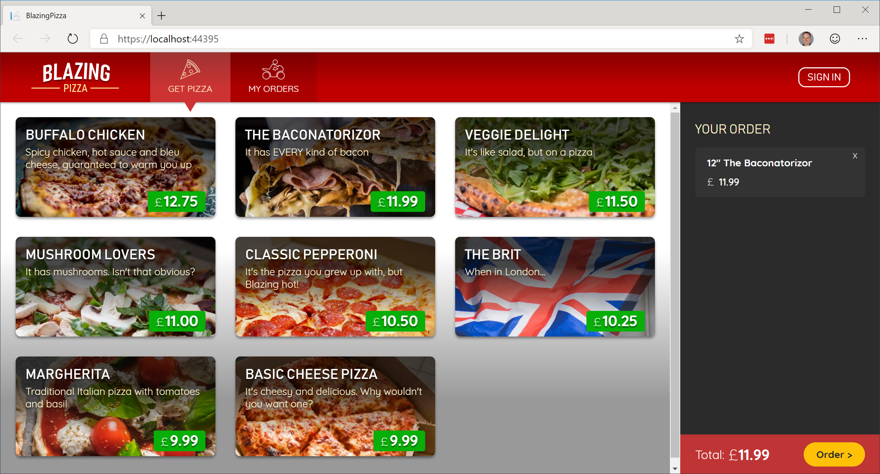
Build your own pizza store UI with Blazor
https://aka.ms/blazorworkshop

Slide 12



“Telerik UI for Blazor components have been built from the ground-up to ensure you experience shorter development cycles, quick iterations and cut time to market”
https://www.telerik.com/blazor-ui
“DevExpress UI for Blazor ships with 12 UI components (including a Data Grid, Pivot Grid, Charts and Scheduler) so you can design rich user experiences for both Blazor server-side and Blazor client-side platforms.”
https://www.devexpress.com/blazor
“The Syncfusion ASP.NET Core Blazor Components library is the only suite that you will ever need to build an application, containing over 60 high-performance, lightweight, modular, and responsive UI controls in a single package.”
https://www.syncfusion.com/blazor-components

Slide 13
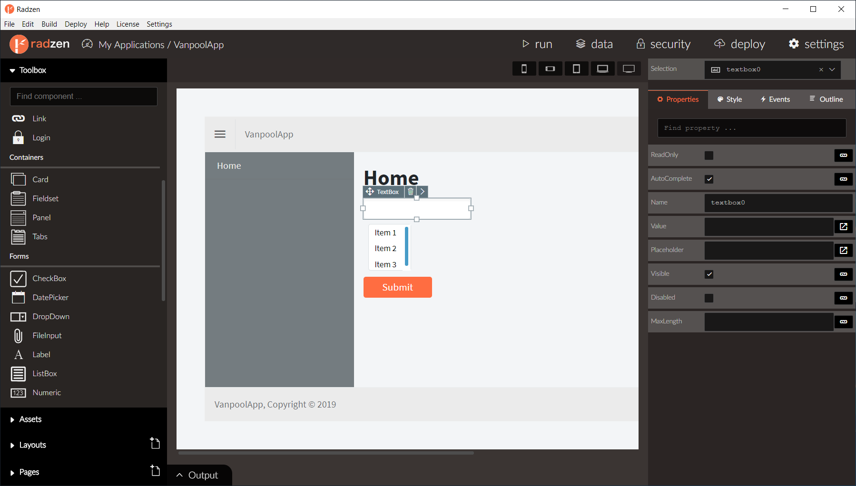
Radzen – Blazor WYSIWYG designer & UI components

Slide 14
The “Awesome Blazor” community
https://aka.ms/awesomeblazor
Free open-source components & JS interop libraries
Lots of fun sample Blazor apps
Articles, videos, blogs, and other learning materials
Chat with the Blazor community on Gitter: https://gitter.im/aspnet/blazor
Thank you, Simon and Chris!

Slide 15
Blasteroids
https://aka.ms/blasteroids

Slide 16
Summary
Blazor Server now available with .NET Core 3.0
Build full-stack web apps with C# and .NET
Rich component model and UI framework
Integrates with existing ASP.NET Core apps
Blazor WebAssembly coming in May 2020

Slide 17
Try Blazor today!
Blazor: https://blazor.net
Docs: https://blazor.net/docs
.NET Core 3.0: https://dot.net/get-core3
Visual Studio: https://visualstudio.com/
Workshop: https://aka.ms/blazorworkshop
Community: https://aka.ms/awesomeblazor

Slide 18
Obrigado!!!
Toptal:
https://www.toptal.com/#discover-only-perfect-developers
GitHub:
https://github.com/andersonferrari/BlazorWeather/
LinkedIn:
https://www.linkedin.com/in/andersonluizferrari/

